Slide 1
C++ for Advanced Mathematical Finance
Simon Hartley

Slide 2
Introduction – SYLLABUS
BLOCK 1: INTRODUCTION TO PROGRAMMING
introduces basic concepts of programming in C++
Data Types
Input/output
If statements
For/while/do loops
Functions
Pointers.

Slide 3
Introduction – Why C++?
• Performance
• Standards compliance
• Existing libraries
• Multi-paradigm language
• High-level features

Slide 4
Introduction – C++ History
C++ is a programming language. A standardized, general-purpose, object-oriented, compiled language.
C++ is accompanied by a set of functions and containers called the C++ Standard-Library. Bjarne Stroustrup created C++ as an extension to a C programming language.
Still, C++ evolved to be a completely different programming language.
Let us emphasize this:
C and C++ are two different languages.
C++ started as “C with classes,” but it is now a completely different language.
So, C++ is not C; C++ is not C with classes; it is just C++.
And there is no such thing as a C/C++ programming language.

Slide 5
Introduction – Standards and Modern C++
C++ is governed by the ISO C++ standard.
Every C++ standard starting with the C++11 onwards is referred to as “Modern C++.”
Year | C++ Standard | Informal name
1998 | ISO/IEC 14882:1998 | C++98
2003 | ISO/IEC 14882:2003 | C++03
2011 | ISO/IEC 14882:2011 | C++11, C++0x
2014 | ISO/IEC 14882:2014 | C++14, C++1y
2017 | ISO/IEC 14882:2017 | C++17, C++1z
2020 | ISO/IEC 14882:2020 | C++20, C++2a

Slide 6
Introduction – C++20
the latest ISO C++ standard is C++20.
Modules
Ranges
Coroutines
Concepts
Lambda Expression Changes
[=, this] as Lambda Capture
Templated Lambda Expressions
Pack Expansion in Lambda Captures
constexpr Changes
virtual functions
union, try/catch, dynamic_cast, typeid
allocations
constexpr string & vector
Concurrency Changes
Atomic Smart Pointers
Joining & Cancellable Threads
The C++20 Synchronization Library
Semaphores, efficient atomic waiting, latches, and barriers
std::atomic_ref
Designated Initializers
Spaceship Operator <=>
Range-based for Loop Initializer
Non-Type Template Parameters
[[likely]] and [[unlikely]]
Calendars & Timezones
std::span
Feature Test Macros
<version>
Immediate Functions – consteval
constinit
Class Enums and using Directive
Text Formatting
Math Constants
std::source_location
[[nodiscard(reason)]]
Bit Operations
Small Standard Library Additions

Slide 7
Introduction – C++ Identifiers
An identifier is an arbitrarily long sequence of digits, underscores, lowercase and uppercase Latin letters, and most Unicode characters. A valid identifier must begin with a non-digit character (Latin letter, underscore, or Unicode non-digit character). Identifiers are case-sensitive (lowercase and uppercase letters are distinct), and every character is significant.

Slide 8
Introduction – C++ Identifiers
weight_kg = 60;
From now on, whenever we use weight_kg, C++ will look at that memory for the value we assigned to it. In layman’s terms, a identifier is a name for a value.
In C++, variable names can include letters, digits, and underscores cannot start with a digit are case sensitive. This means that, for example:
weight0 is a valid variable name,
0weight is not as begins with a number
weight and Weight are different variables

Slide 9
Introduction – C++ Identifiers
The names of variables : For instance: a_local_variable, _struct_data_member, a_class_data_member_.
Common Variable names
For example:
std::string table_name; // OK - lowercase with underscore. std::string tableName; // Bad - mixed case
This is called a programming Style see:
google C++ code Style

Slide 10
Introduction – C++ Keywords
The following list shows the reserved words in C++. These reserved words may not be used as constant or variable or any other identifier names.
A – C
alignas (since C++11) alignof (since C++11) and and_eq asm atomic_cancel (TM TS) atomic_commit (TM TS) atomic_noexcept (TM TS) auto (1) | bitand bitor bool break case catch char char8_t (since C++20) char16_t (since C++11) char32_t (since C++11) class (1) | compl concept (since C++20) const consteval (since C++20) constexpr (since C++11) constinit (since C++20) const_cast continue co_await (since C++20) co_return (since C++20) co_yield (since C++20)
(1) — meaning changed or new meaning added in C++11.
(2) — meaning changed in C++17.
(3) — meaning changed in C++20.

Slide 11
Introduction – C++ Keywords
The following list shows the reserved words in C++. These reserved words may not be used as constant or variable or any other identifier names.
D – P
decltype (since C++11) default (1) delete (1) do double dynamic_cast else enum explicit export (1) (3) extern (1) false float for | friend goto if inline (1) int long mutable (1) namespace new noexcept (since C++11) not not_eq | nullptr (since C++11) operator or or_eq private protected public
(1) — meaning changed or new meaning added in C++11.
(2) — meaning changed in C++17.
(3) — meaning changed in C++20.

Slide 12
Introduction – C++ Keywords
The following list shows the reserved words in C++. These reserved words may not be used as constant or variable or any other identifier names.
Q – Z
reflexpr (reflection TS) register (2) reinterpret_cast requires (since C++20) return short signed sizeof (1) static static_assert (since C++11) static_cast | struct (1) switch synchronized (TM TS) template this thread_local (since C++11) throw true try typedef typeid typename | union unsigned using (1) virtual void volatile wchar_t while xor xor_eq
(1) — meaning changed or new meaning added in C++11.
(2) — meaning changed in C++17.
(3) — meaning changed in C++20.

Slide 13


Introduction – C++ Process
Your C++ Program
( .cpp, .h)
Standard Headers
#include <string>
pre-processor
Object files .o
Compiler
Standard Libraries
Linker
.exe, .lib, .so
Executable

Slide 14
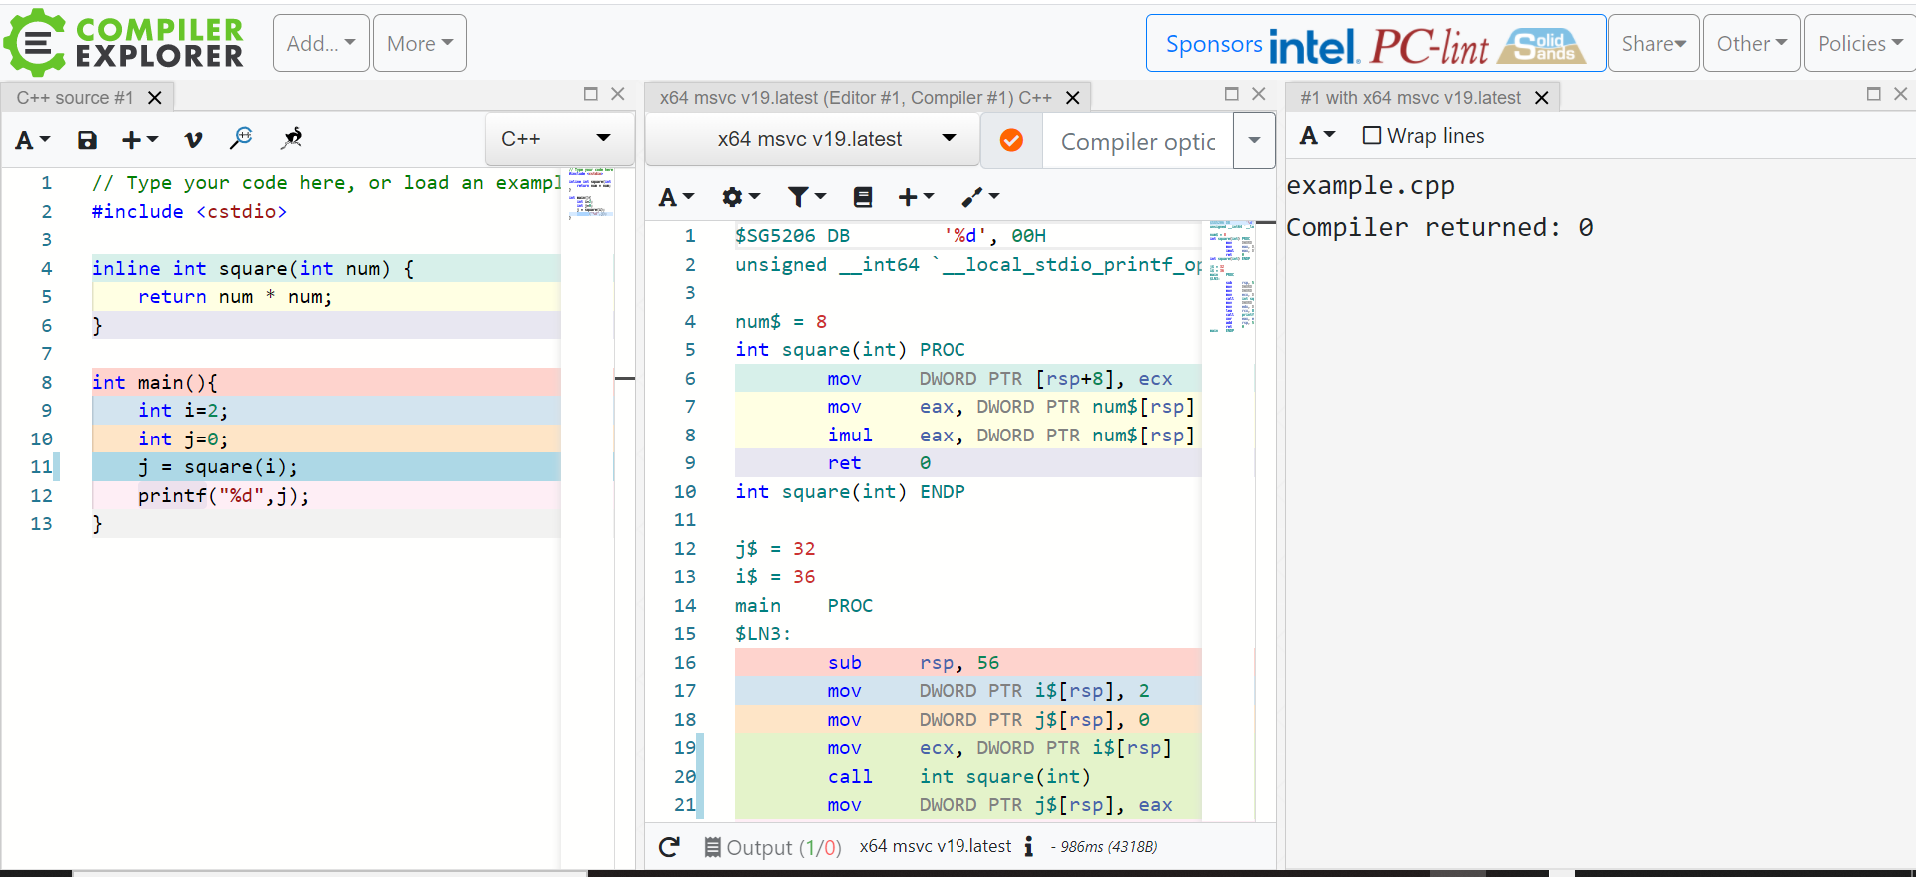
Introduction – C++ Compilers
To see the compiler output and Compare Compilers See https://godbolt.org/

Slide 15

Introduction – MSVC Compiler
Available at: https://intranet.birmingham.ac.uk/it/services/free-software.aspx

